Slide 1

ASSET MANAGEMENT
TRAINEE NAME : YAKESH BALAJI RAJA P
TRAINER NAME : JAVEED MOHAMMED HUSNUDDIN

Slide 2
About Project
The Asset Management System is a microservices-based web application designed to automate, streamline, and manage the complete lifecycle of assets within an organization. This system allows organizations to maintain control over their assets from acquisition to disposal while ensuring operational efficiency.
This platform serves as a centralized hub for all asset-related operations and supports user roles such as employees and administrators. By replacing manual, or spreadsheet-based tracking methods with a robust digital solution, the application reduces human error, improves data accuracy, and speeds up decision-making.

Slide 3

Technologies Used
FRONTEND
BACKEND
Framework: Angular 15
UI Libraries: Bootstrap
Build Tool: Angular CLI
Framework: Spring Boot (Microservices Architecture)
Language: Java 21
Data Access: Spring Data JPA
Security: Spring Security (JWT)
REST APIs: Exposed via Spring MVC
Logging: SLF4J
Code Simplification: Lombok
INFRASTRUCTURE
Database: MySQL 8
Containerization: Docker
API Testing: Swagger UI
Deployment: Docker Desktop
Monitoring: SonarQube

Slide 4
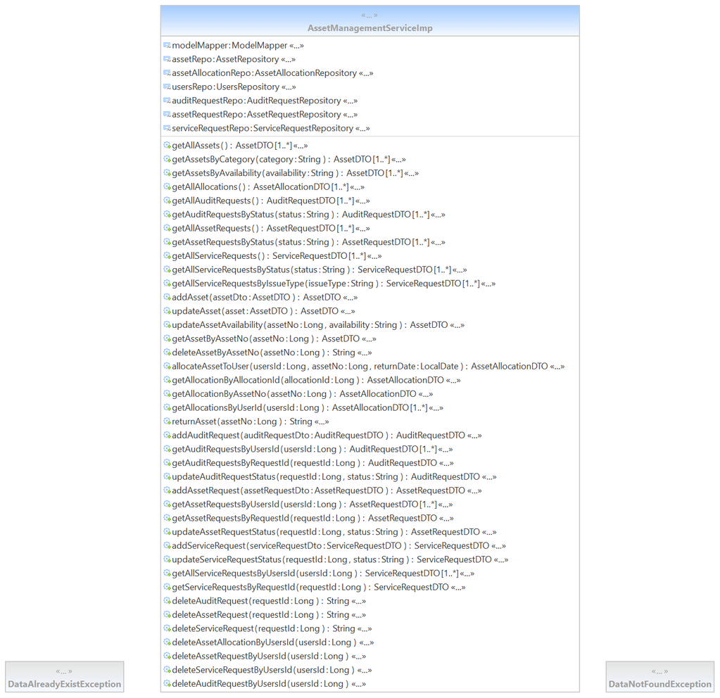
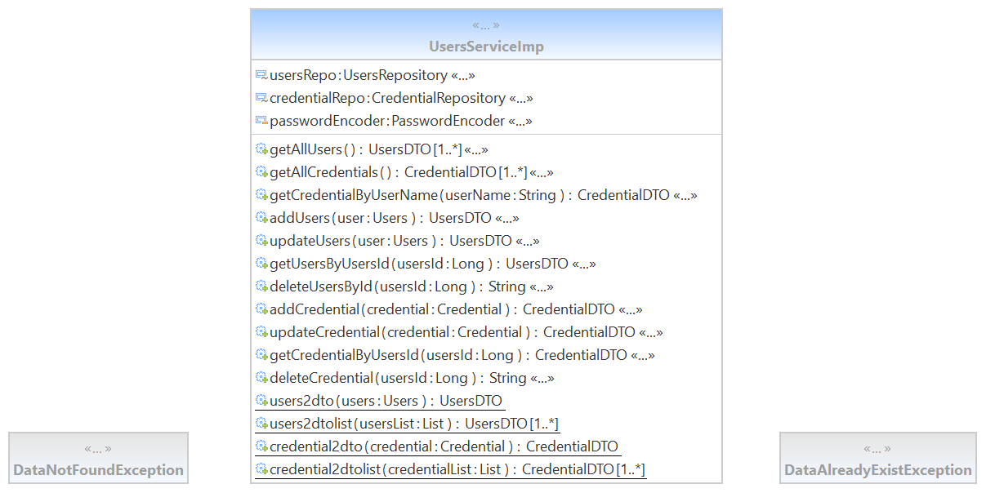
Class Diagram

Slide 5
Screenshots

Slide 6
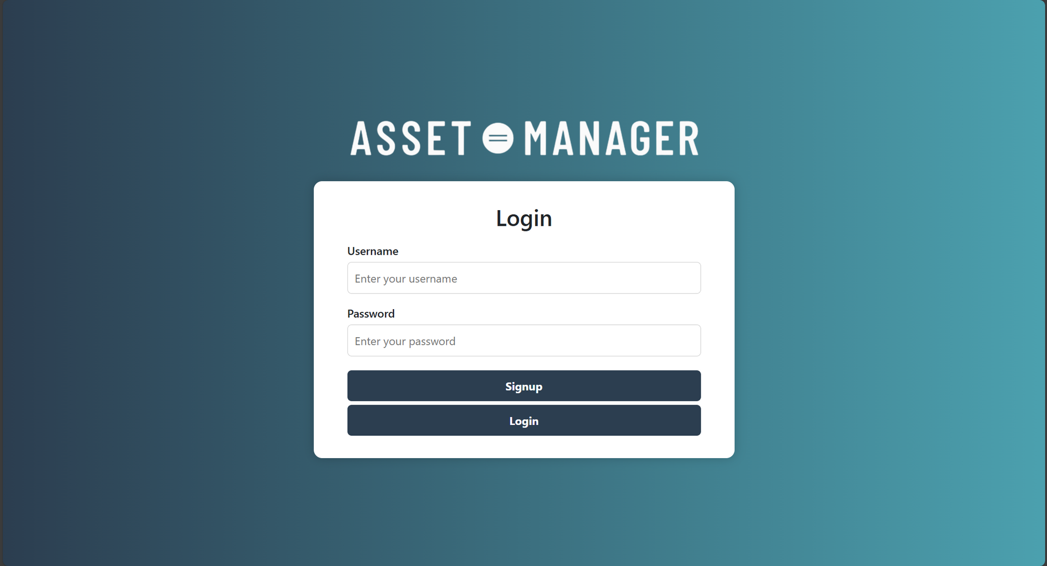
Admin

Slide 7
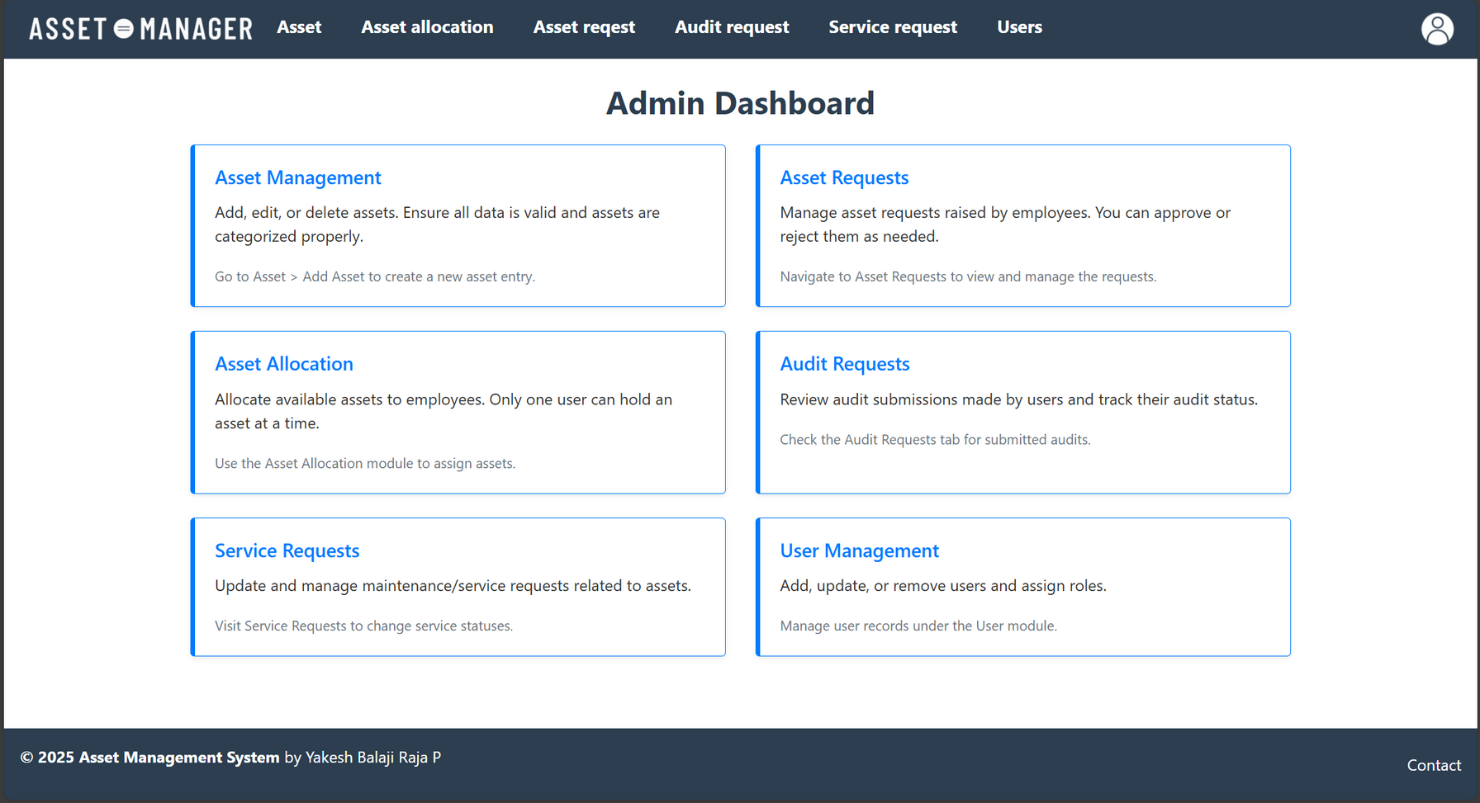

Slide 8
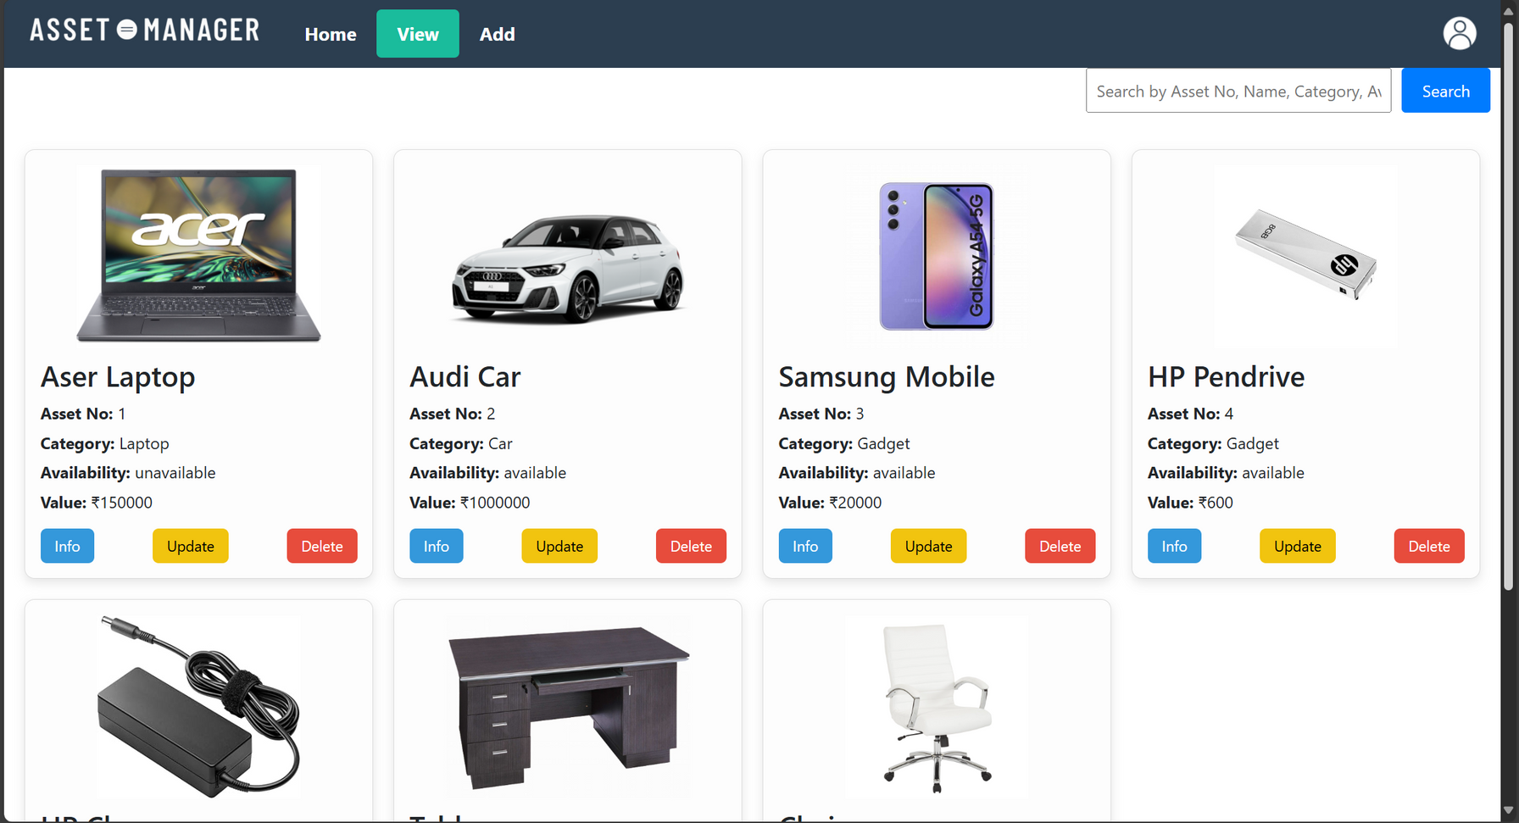

Slide 9
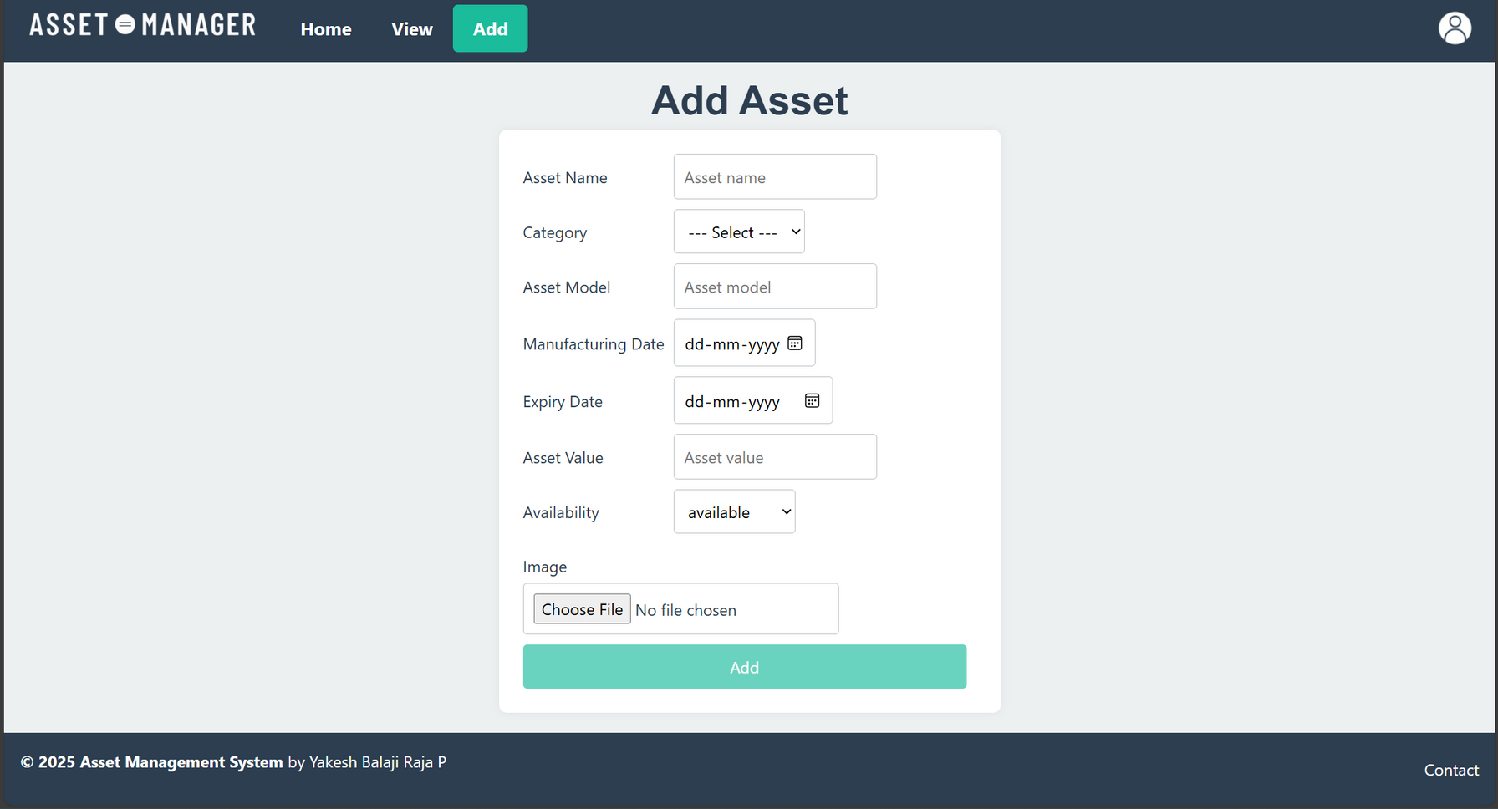

Slide 10
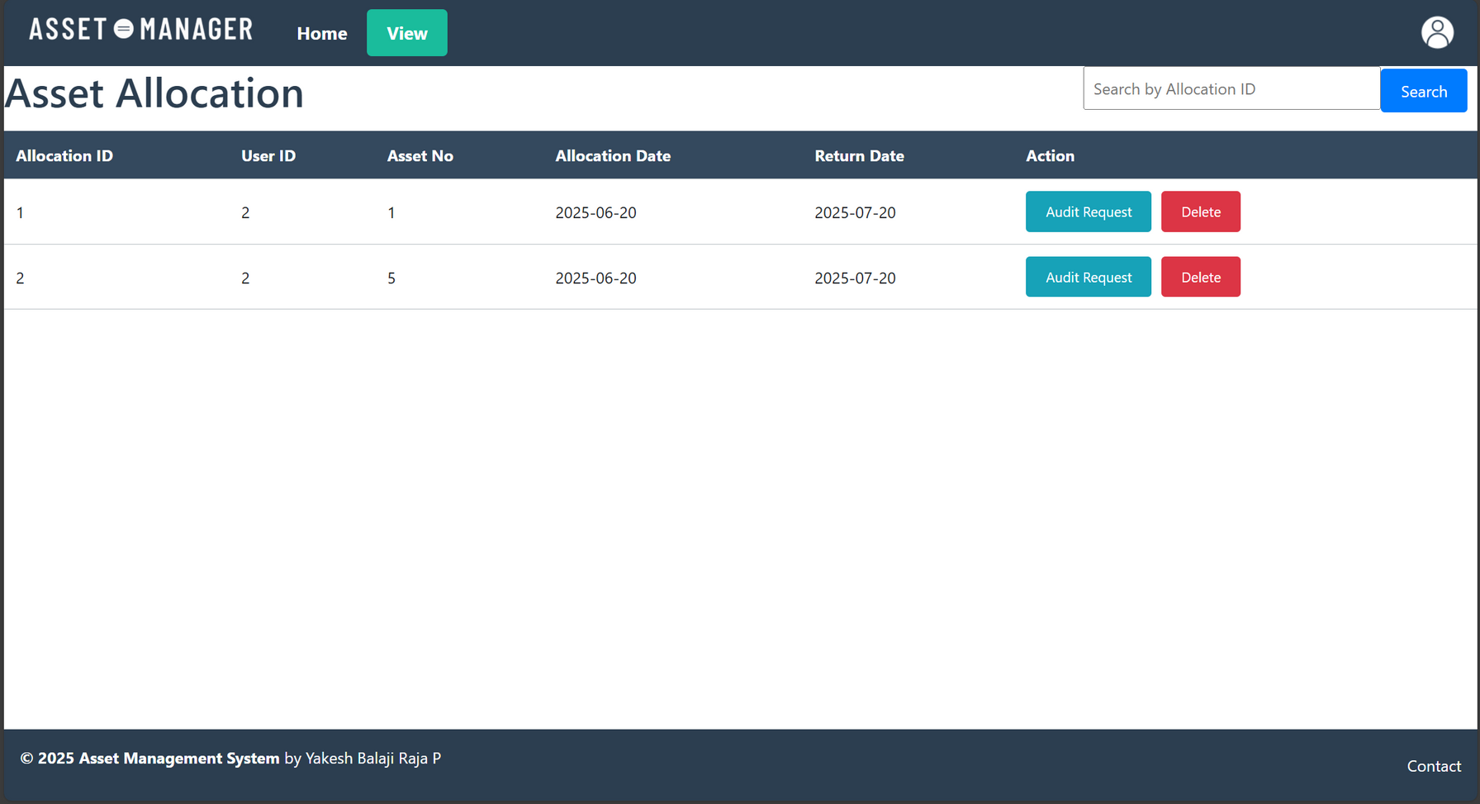

Slide 11
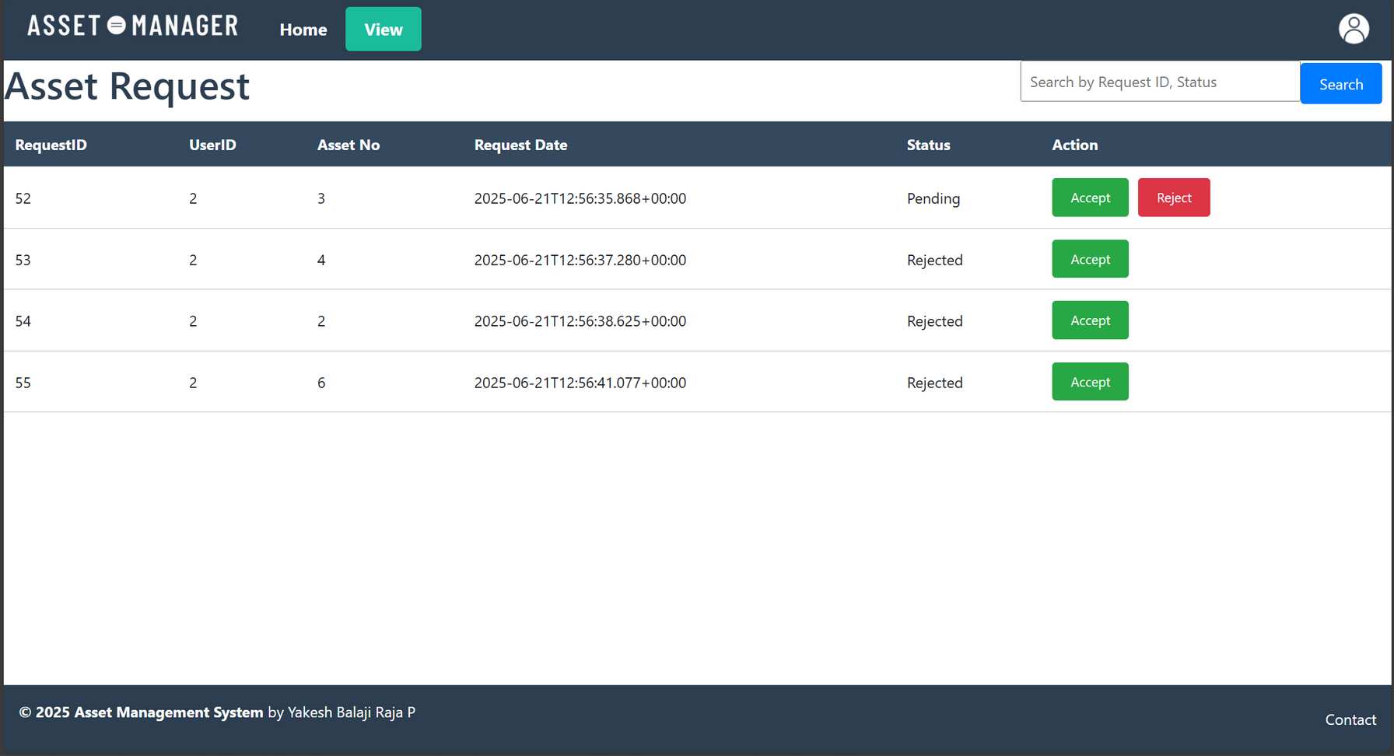

Slide 12
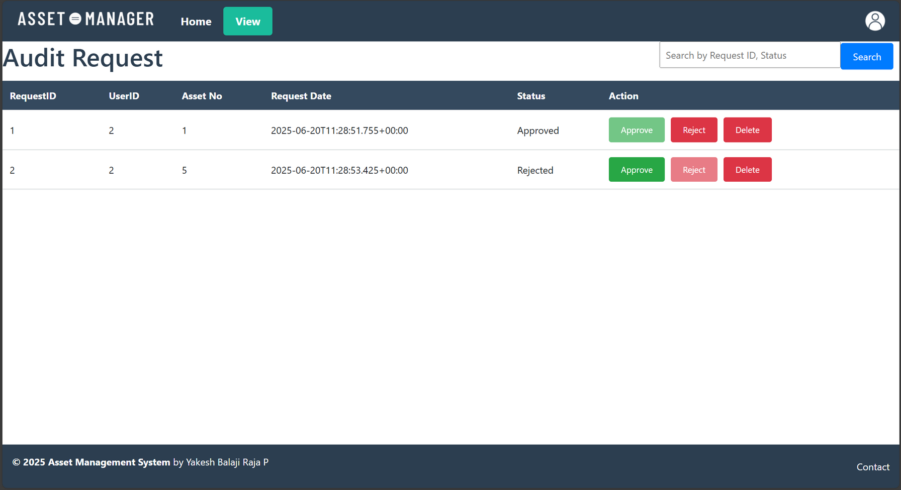

Slide 13
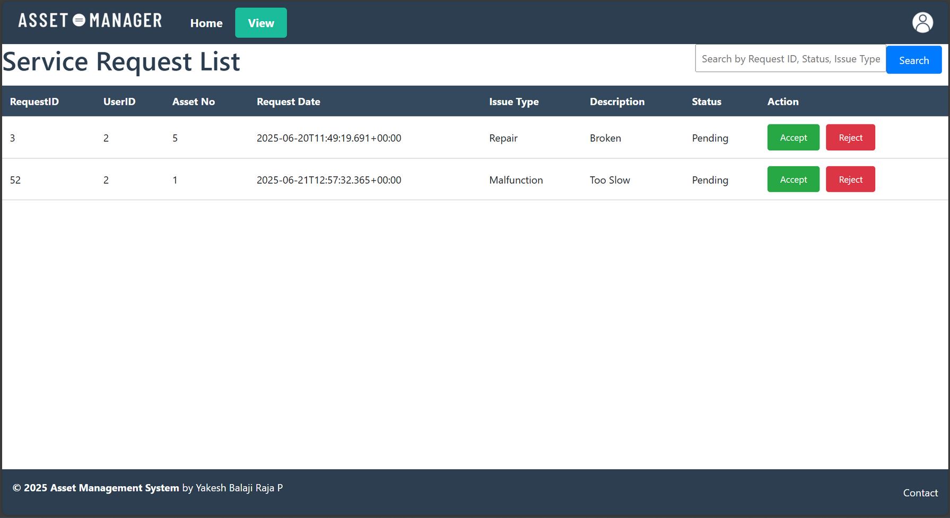

Slide 14
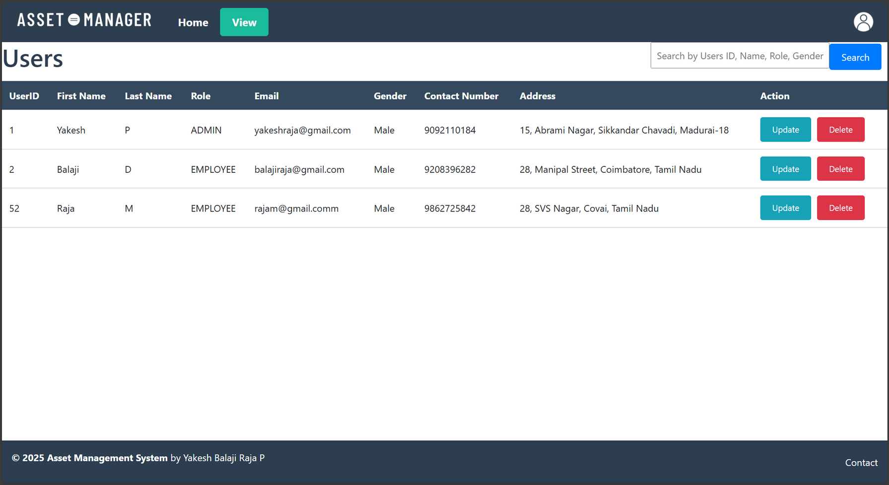

Slide 15
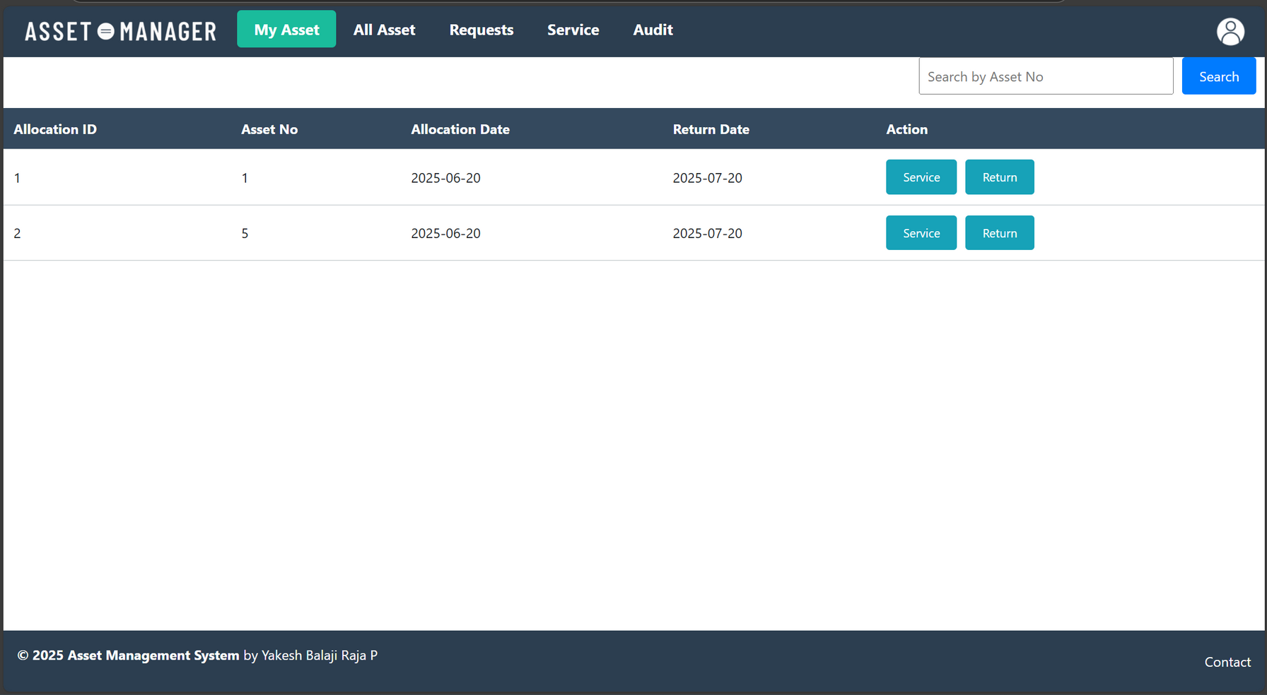
Employee

Slide 16
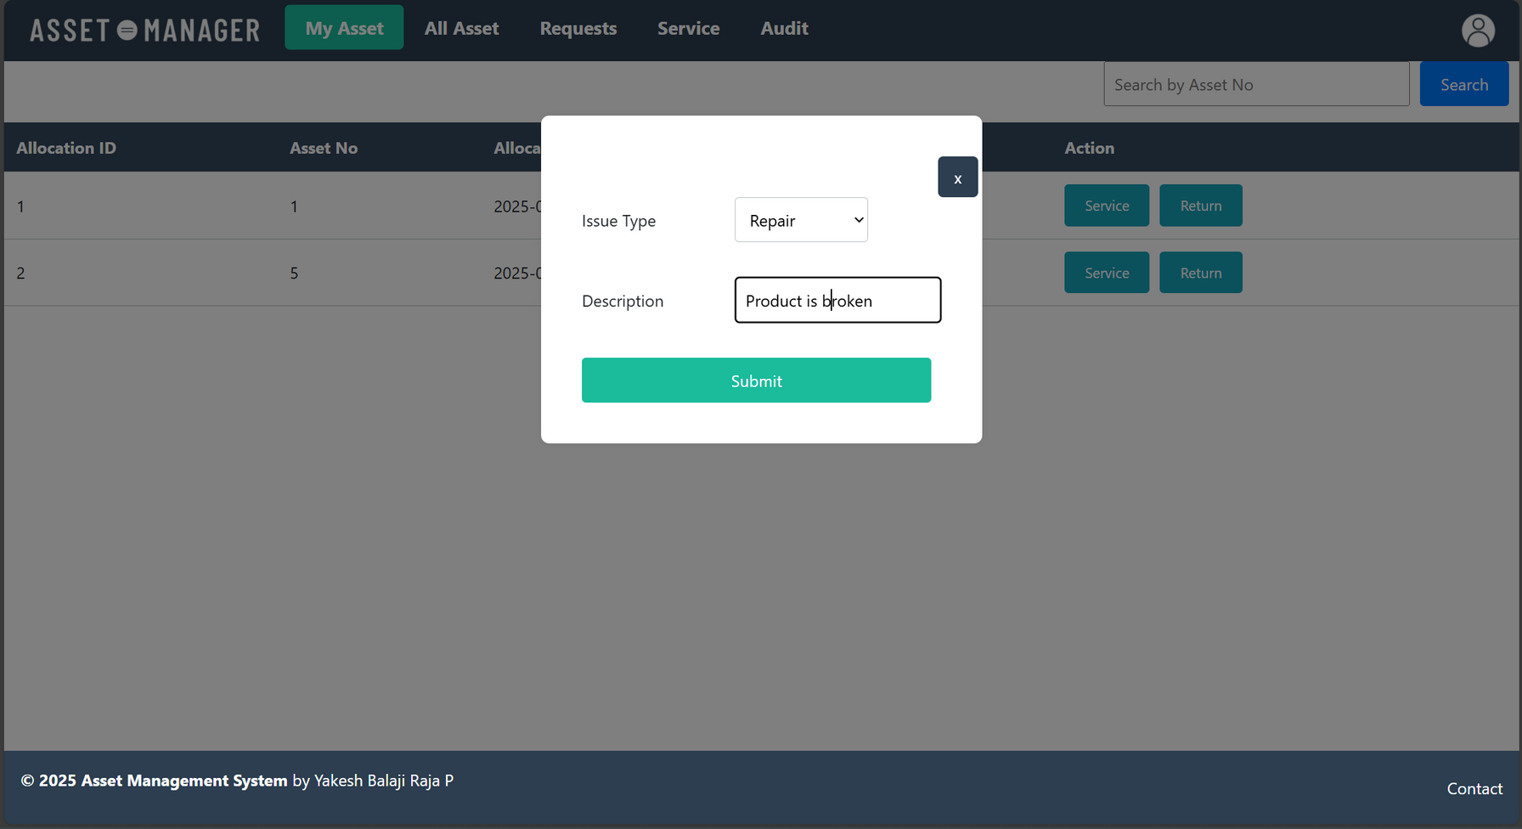

Slide 17
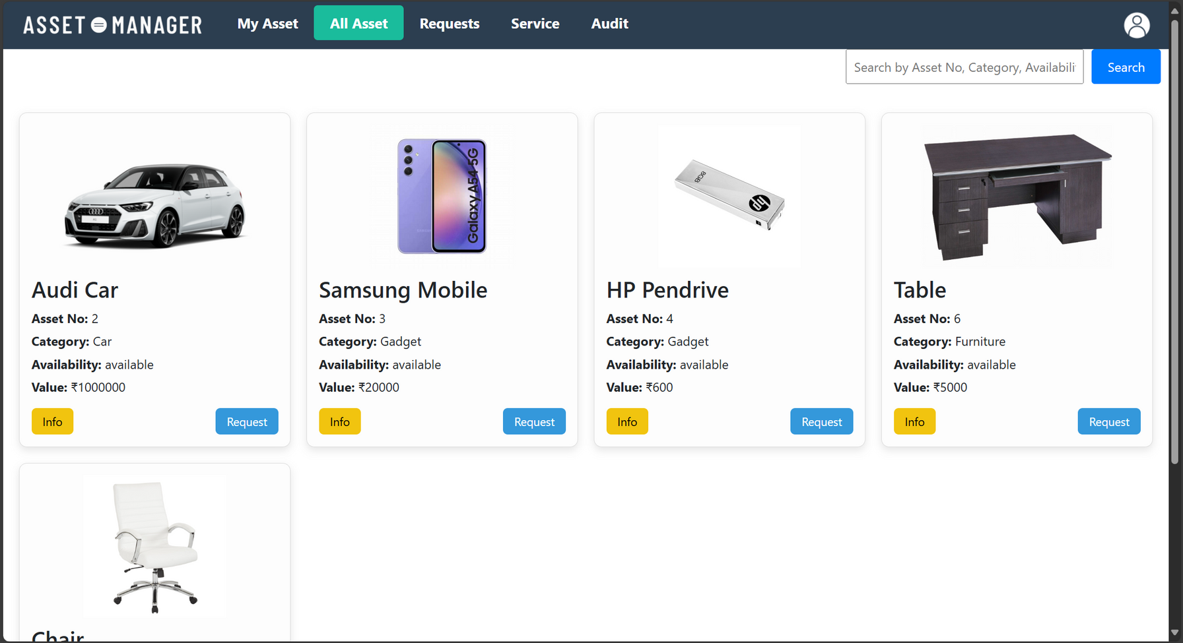

Slide 18
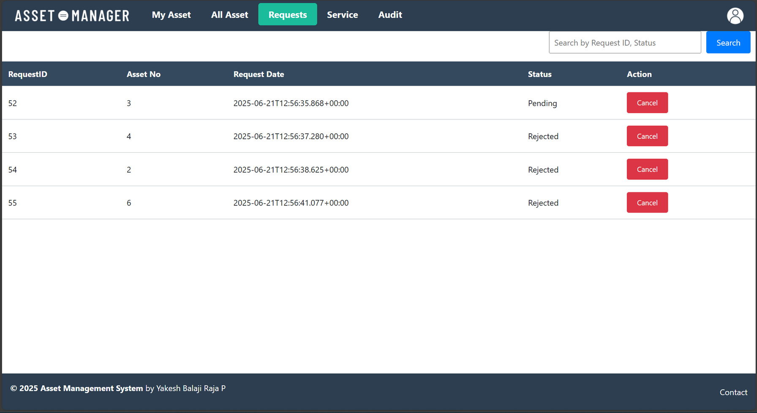

Slide 19
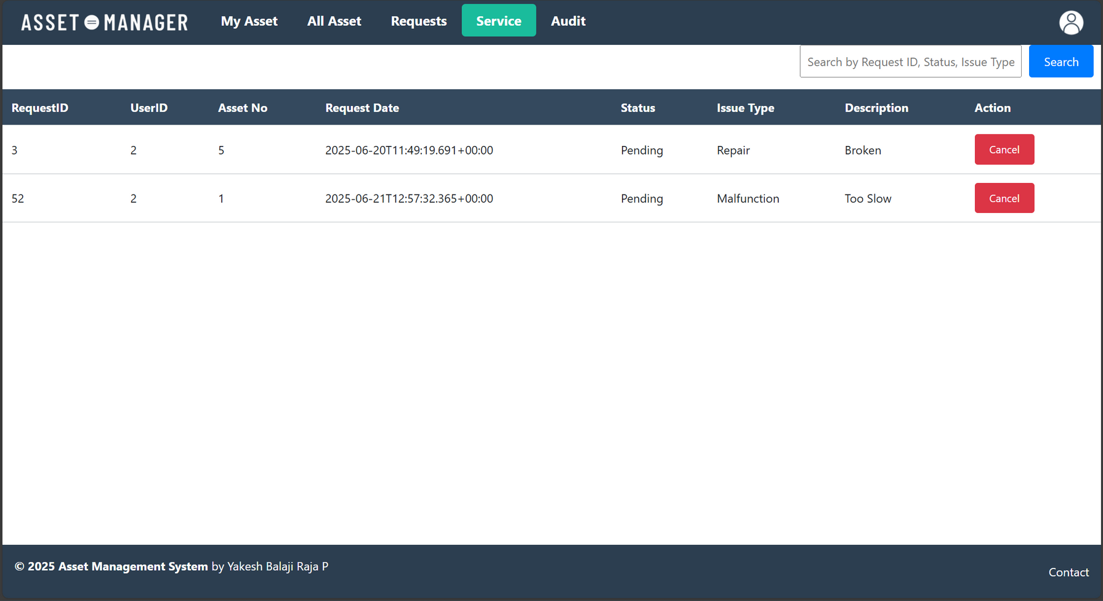

Slide 20
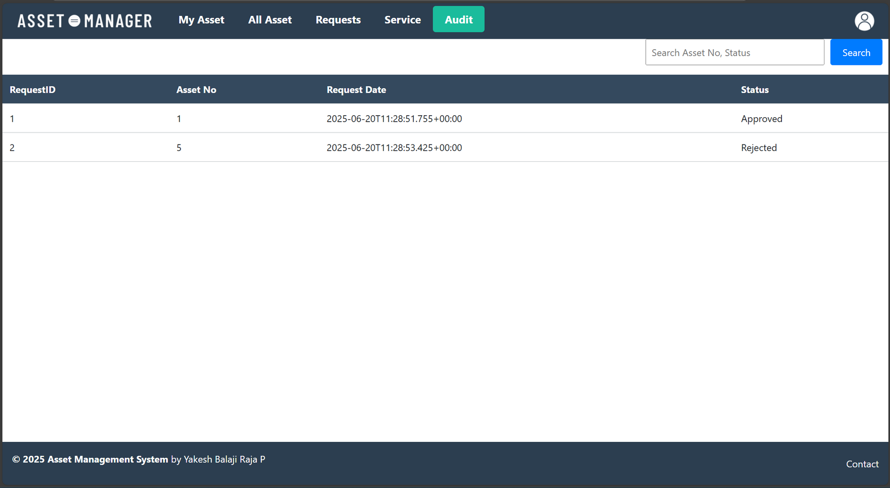

Slide 21
